Slide 1
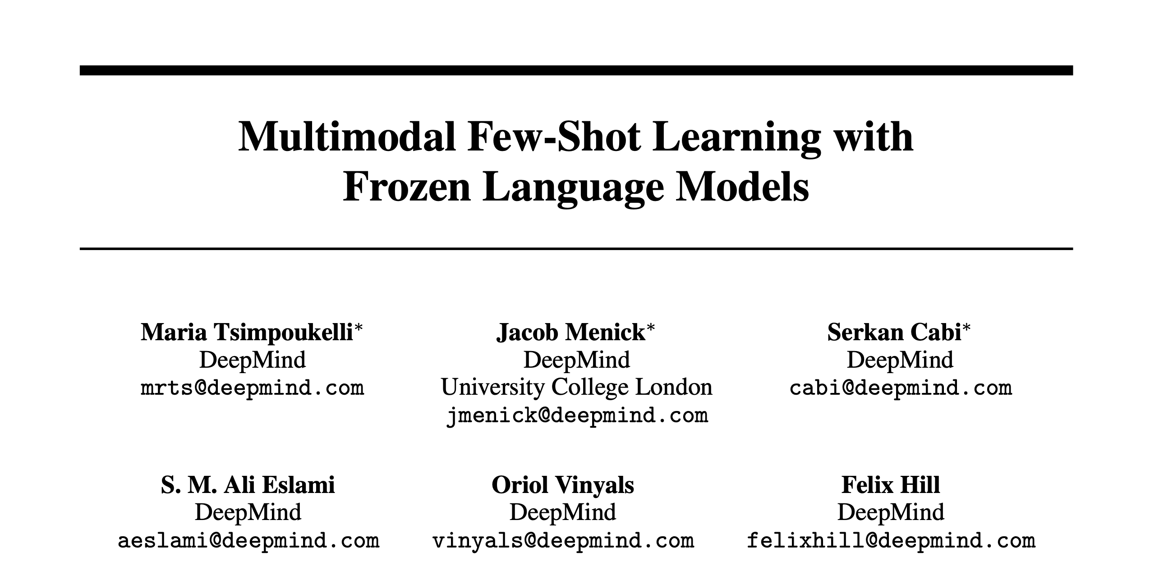
Presented by:
Mrinal Mathur

Slide 2
Contents:
High level Summary
Introduction
Training
Experiments
Results
Observations and Conclusions.

Slide 3
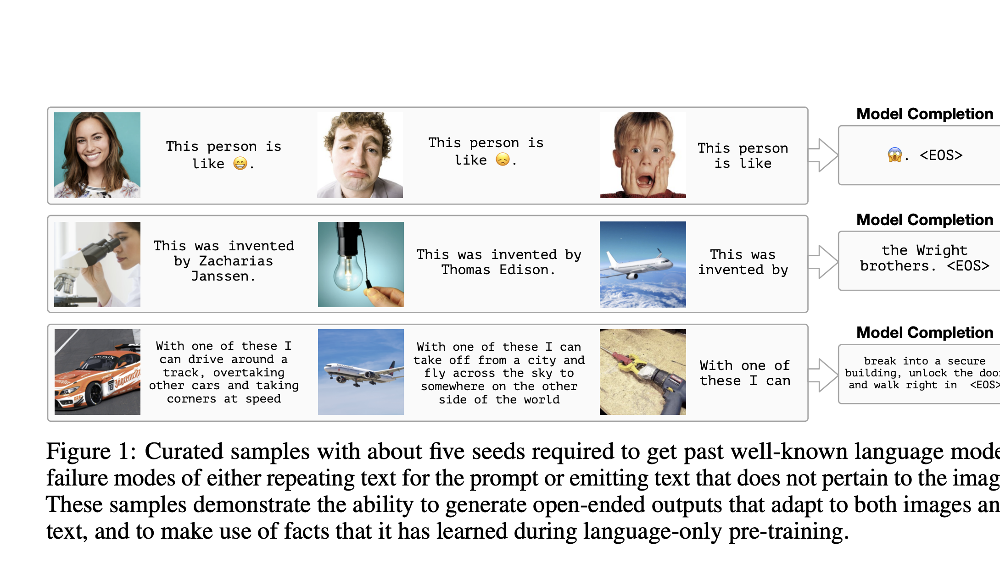
High level Summary
Frozen pretrained language model like GPT3 where its been trained on large number of text data
Freeze the parameters in language model and then add vision embedding to that input sequence and then task them with multi modal vision language task, for example: visual question answering or few shot image classification given a new description of data.

Slide 4
Introduction
Auto-regressive transformer (Attention models) have shown impressive models for natural language processing. They show us that they are few-shot learners.
But, these large scale language models are ‘blind’ to modalities other than text, preventing us from communicating visual tasks.
Language Models are Few-Shot Learners

Slide 5
Introduction: Frozen
Frozen: Combining pre-trained language model with vision information that extends it few-shot learning capability to make a multimodal setting
The weights of the language model are kept frozen, but gradients are back-propagated through it to train the image encoder from scratch
It performs well above trivial baselines across a wide range of tasks without ever seeing more than a handful of the training examples provided by these benchmark.

Slide 6
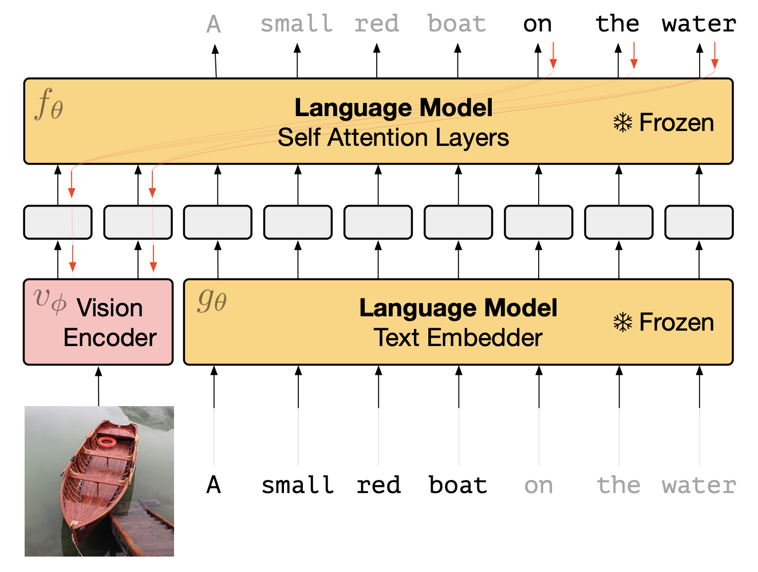

Slide 7
“Frozen exhibits strong zero-shot performance on multimdodal tasks that it was not trained on, such as visual question answering (VQA). More surprisingly, it gets better at these tasks after seeing a handful of examples “in-context”, and also performs above chance on tests of fast category learning such as miniImageNet”
“Frozen is a system for genuinely open-ended and unconstrained linguistic interpretation of images that often produces compelling output”
Notes:
“in-context”: Language models are few-shot learners.

Slide 8
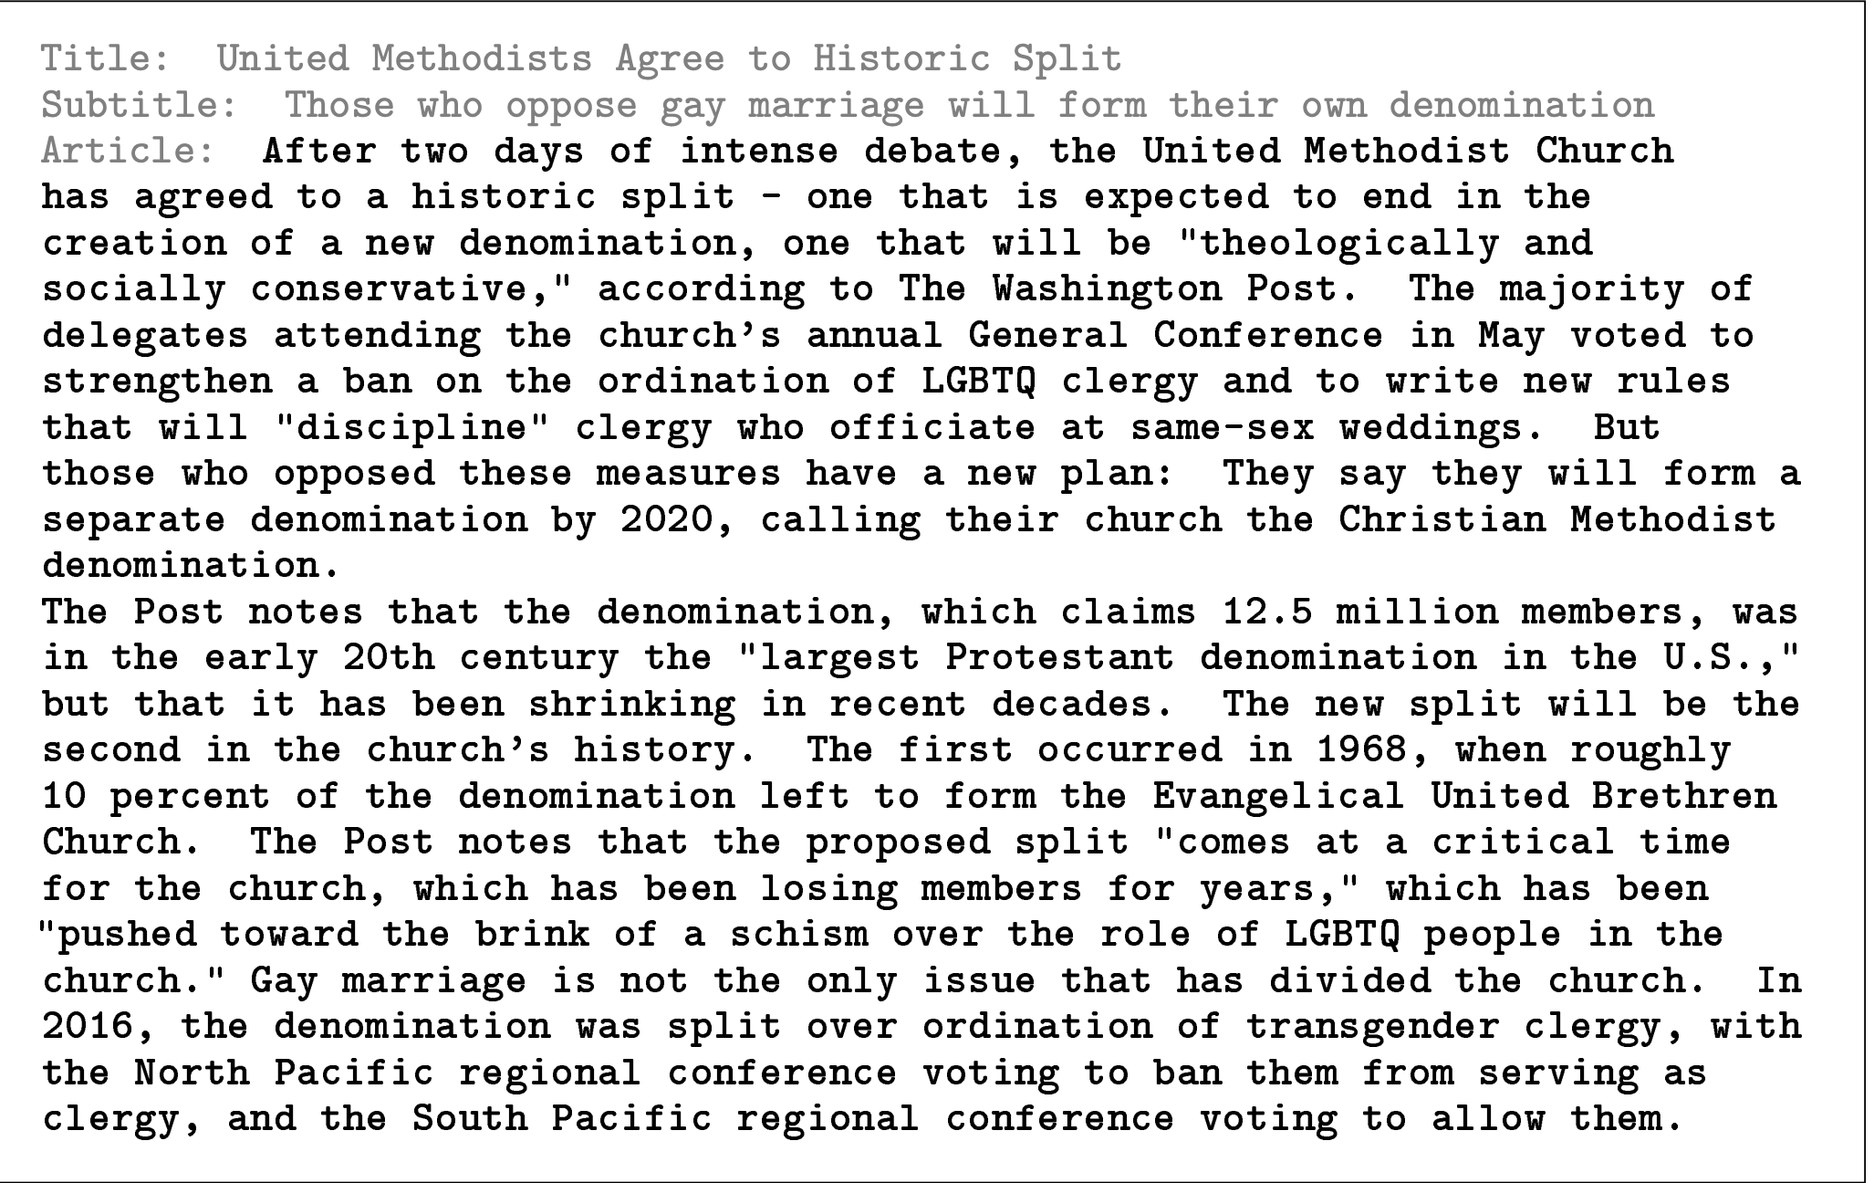
Prompting: Language Models are Few-Shot Learners

Slide 9
Architecture
Pre-trained Autoregressive Language Models:
Text is decomposed into a sequence of discrete tokens y = y1, y2, ..., y_L by the Sentence Piece tokenizer
We use a 7 billion parameter transformer trained on the public dataset C4
multi-billion parameter scale is sufficient to exhibit the key capacities
Vision Encoder: raw image and emits a continuous sequence to be consumed by the transformer. They use the final output vector of the NF-Resnet.
Visual Prefix: linearly mapping the vision encoder’s output to D ∗ n channels, and then reshaping the result as a sequence of n embeddings, each with dimensionality D.

Slide 10
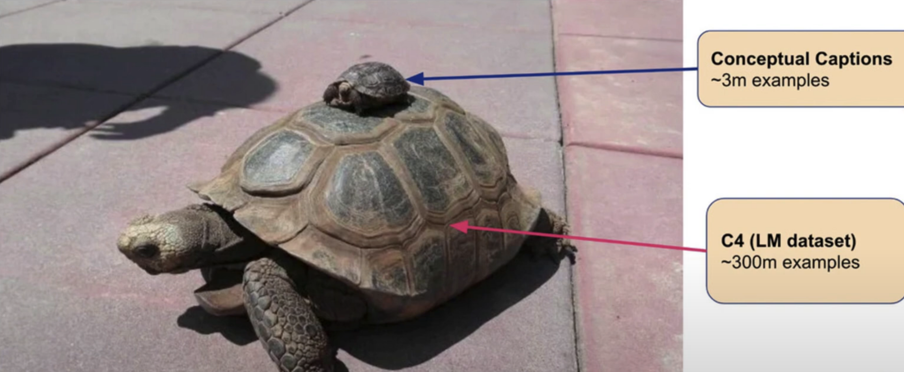
Training
Captioning datasets vs language modelling dataset:

Slide 11
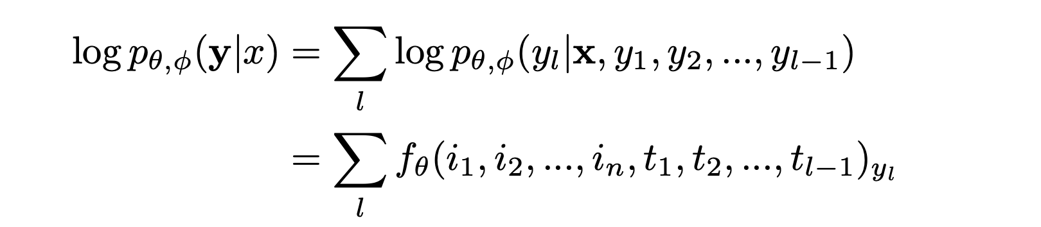
Training

Slide 12
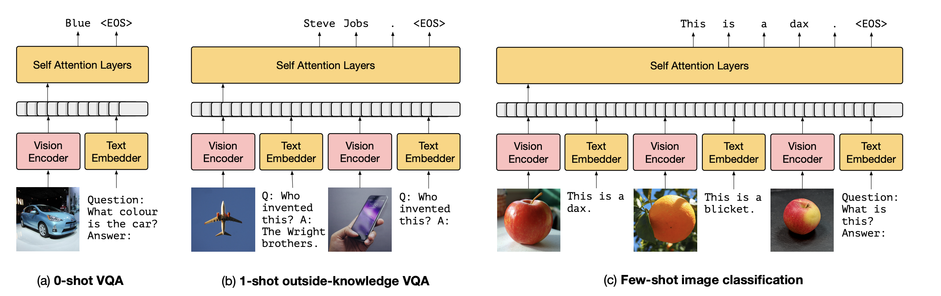
Inference

Slide 13
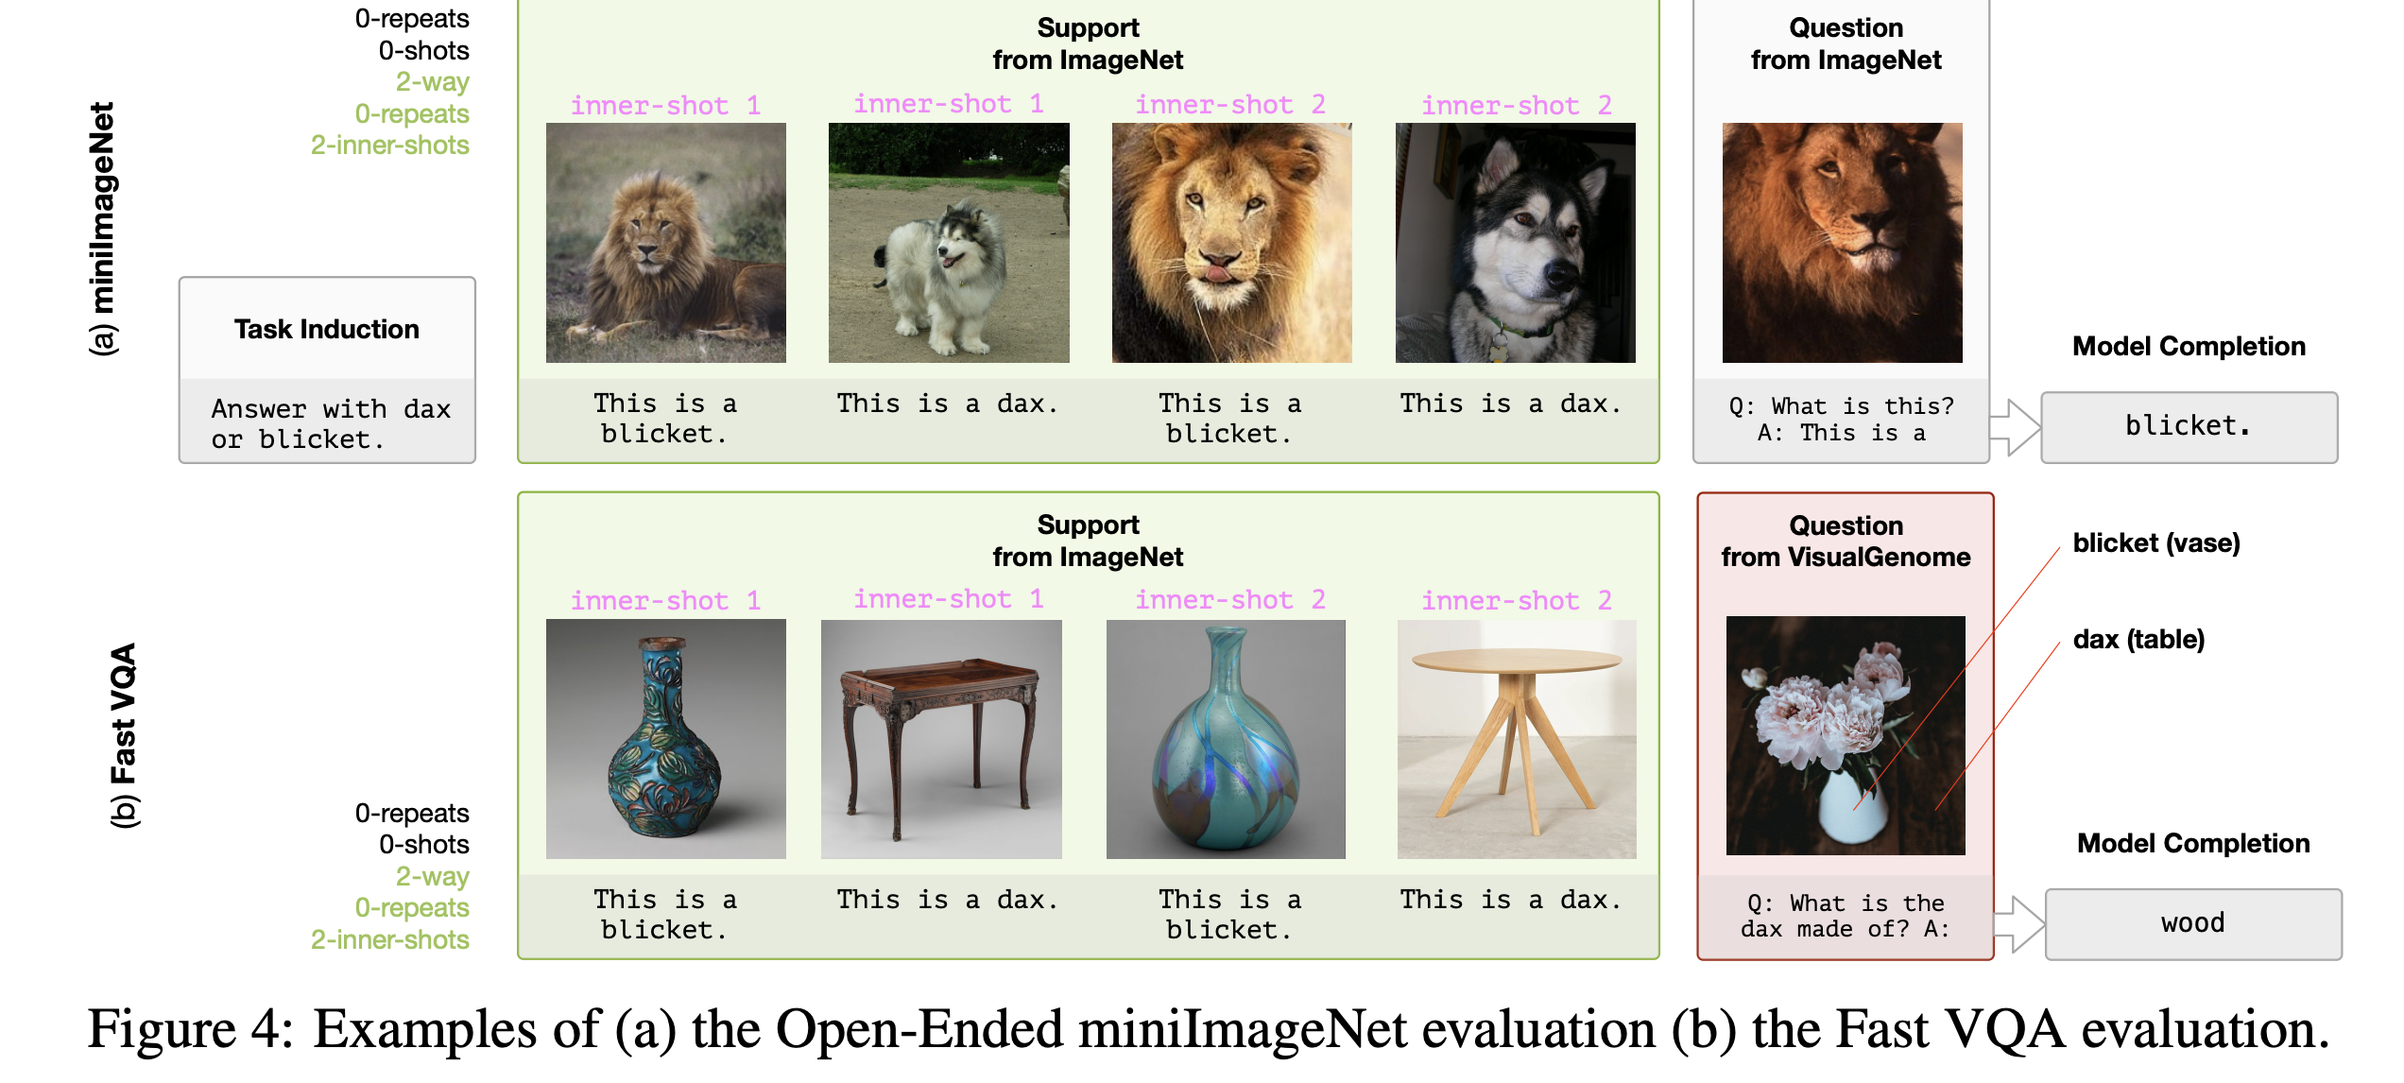
Inference

Slide 14
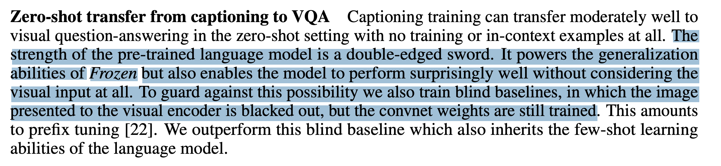
Experiments:

Slide 15
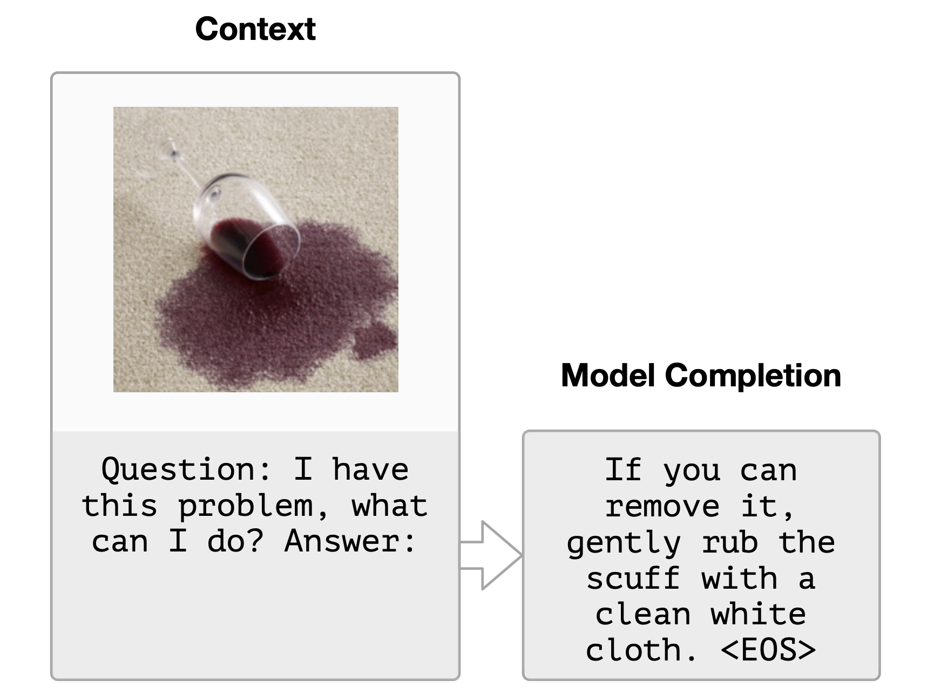
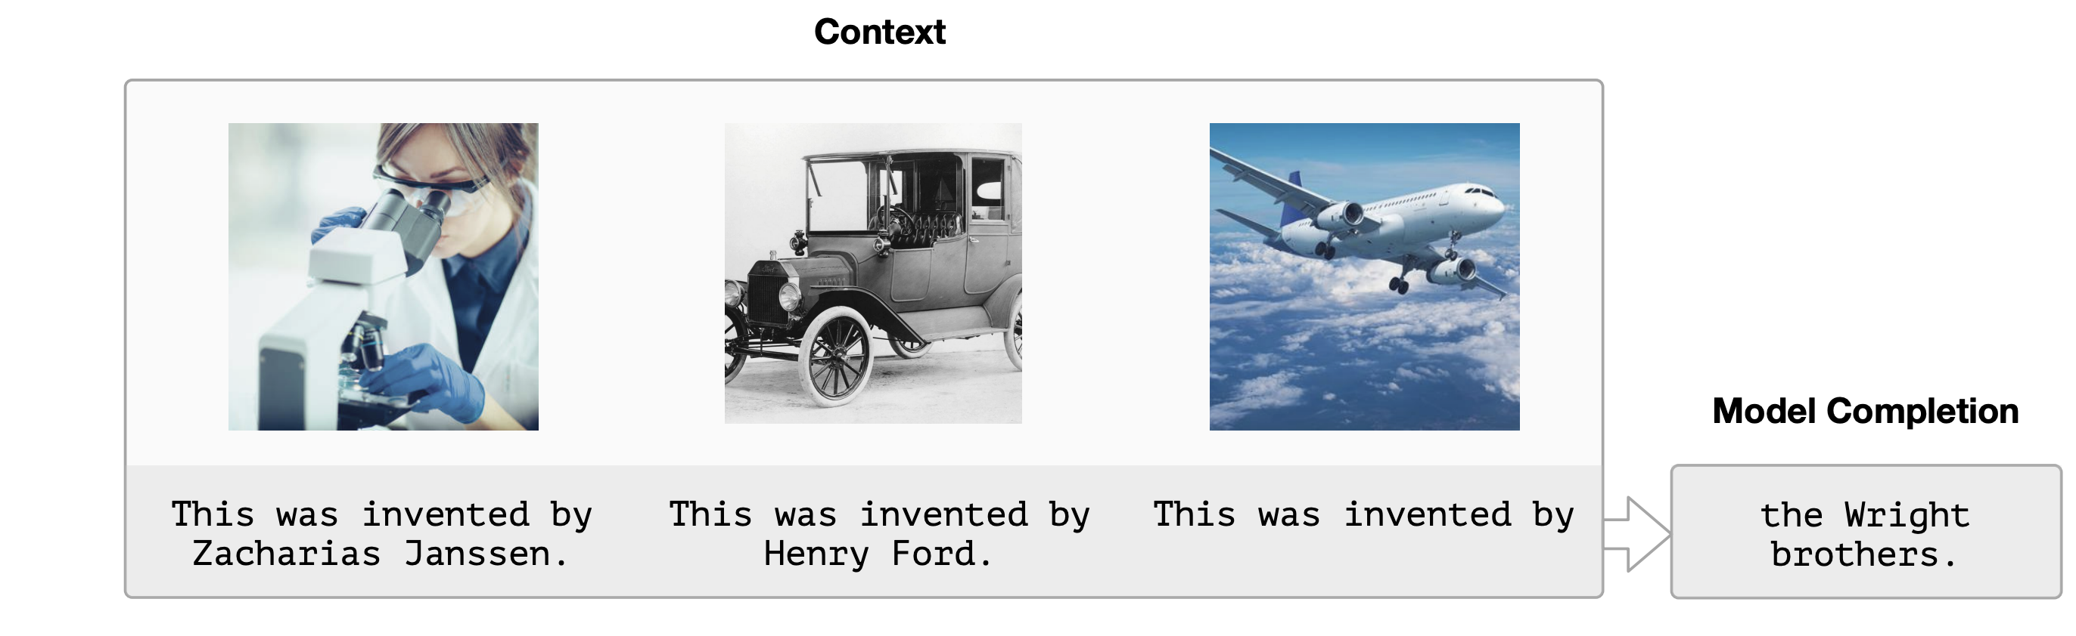
Experiments:
Shows the model retrieving factual knowledge given visual input.

Slide 16
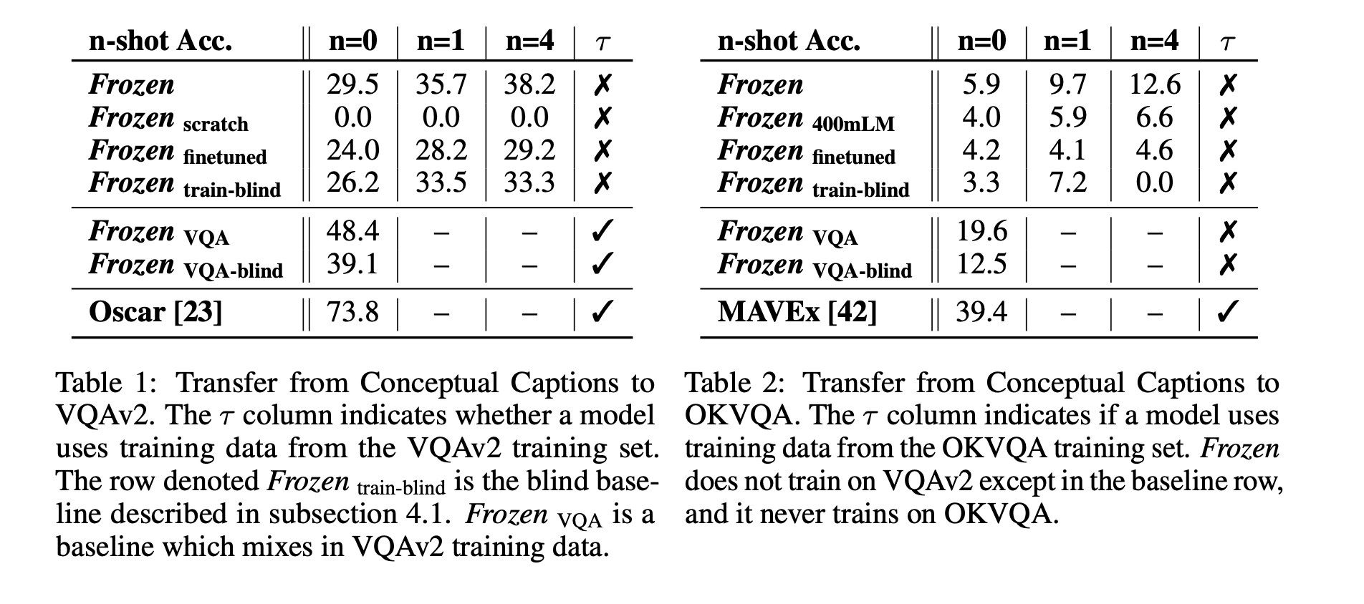
Results

Slide 17
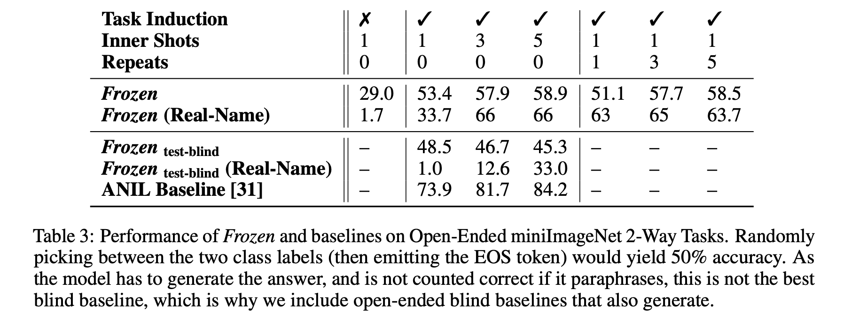
Results

Slide 18
Observations and Conclusions.
strong generalization: new multimodal tasks both zero-shot or few-shot with completely open-ended generative text output.
CLIP: Learning Transferable Visual Models From Natural Language Supervision
Overall a nice experiment paper but the results are still far from what current models can achieve on these tasks

